Slide 1

EcoLedger System for GreenLine Industries

Slide 2
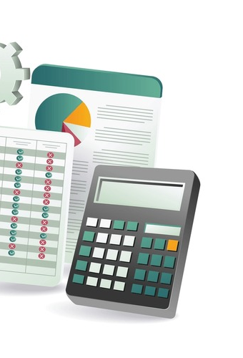
Automated Financial and Inventory Management System
Presented by: MD Habib
Date: 08 -10 -2024

Slide 3
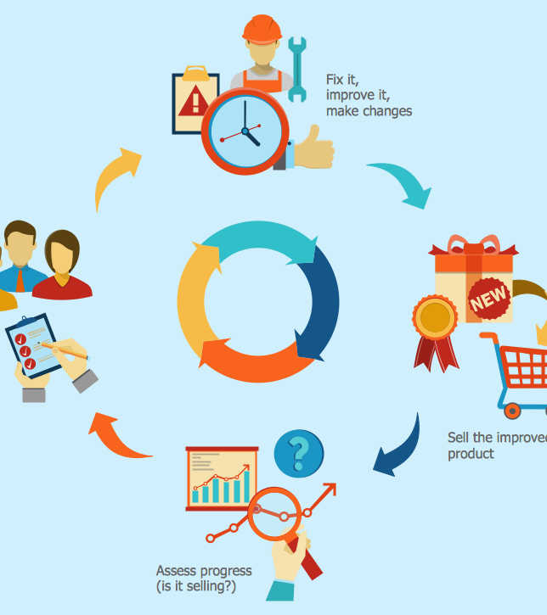
Project Overview
The EcoLedger System is an Excel-based tool designed for GreenLine Industries to automate and streamline financial and inventory management. It integrates automated data entry, real-time reporting, and secure access controls to enhance operational efficiency.

Slide 4
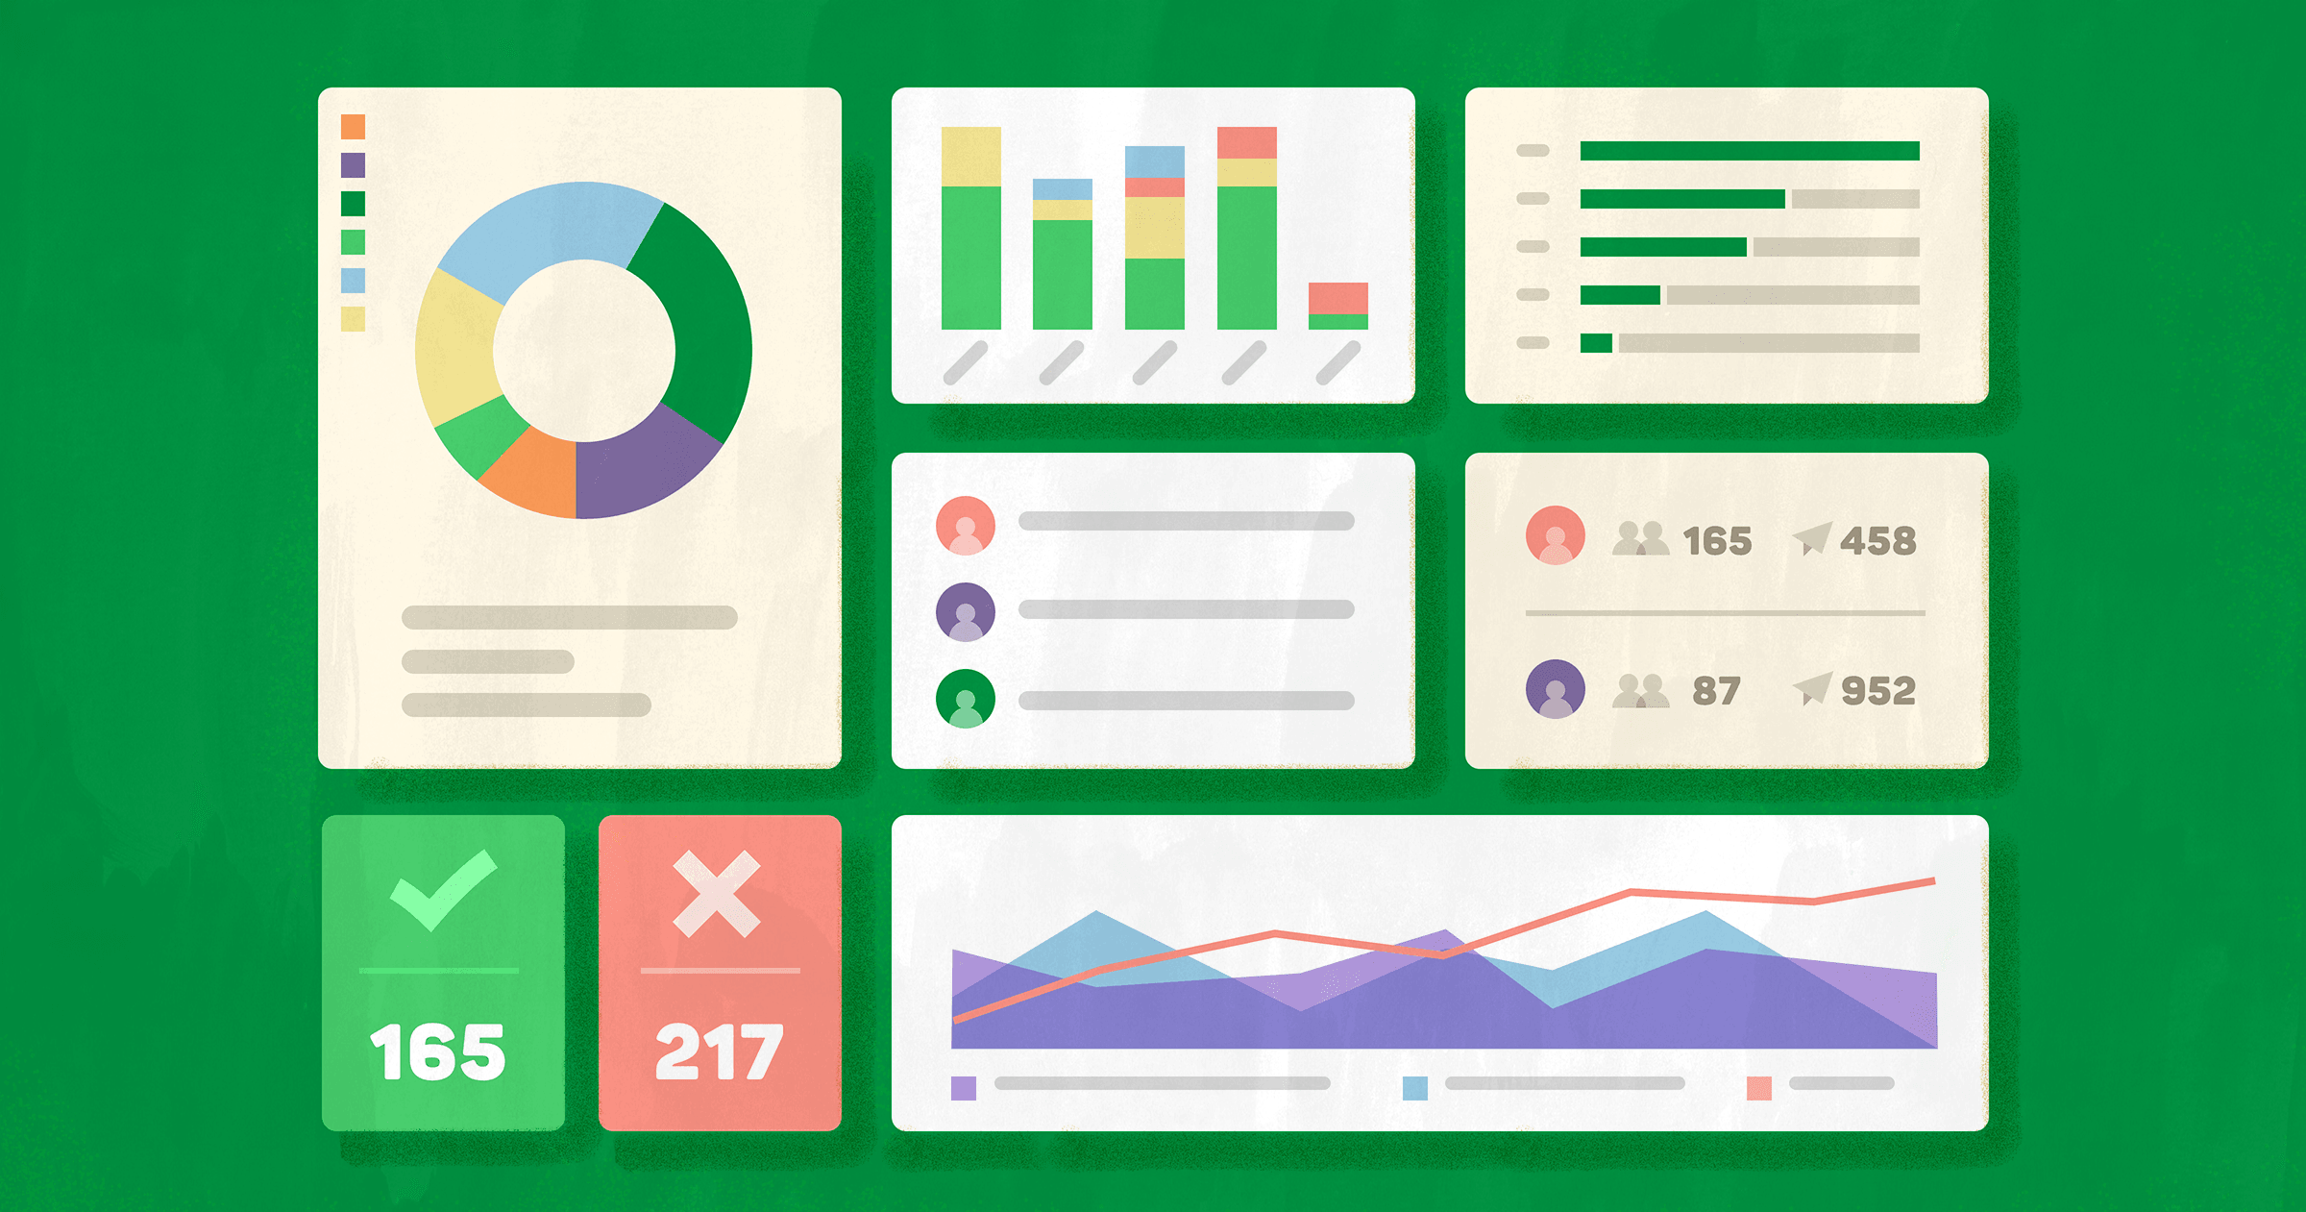
Project Objective
The objective of the EcoLedger System is to:
Automate daily financial and inventory tracking.
Provide real-time insights through dashboards and charts.
Enhance security by protecting sensitive data.
Improve decision-making with detailed reports.

Slide 5
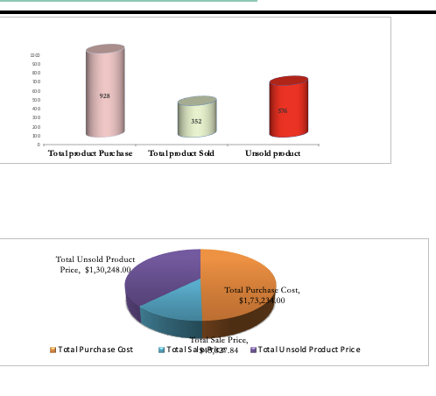
System Structure and Features
The system comprises six functional sheets:
Dashboard: Visual analytics of purchases, sales, unsold inventory, and profits.
Daily Debit/Credit: Automatic cost tracking and calculation.
Report: Generate reports of sold and unsold shipments.
Sales: User forms for adding, editing, and deleting sales data.
Purchase: Record of all purchases, protected from edits.
Admin: Control access and reset passwords.

Slide 6
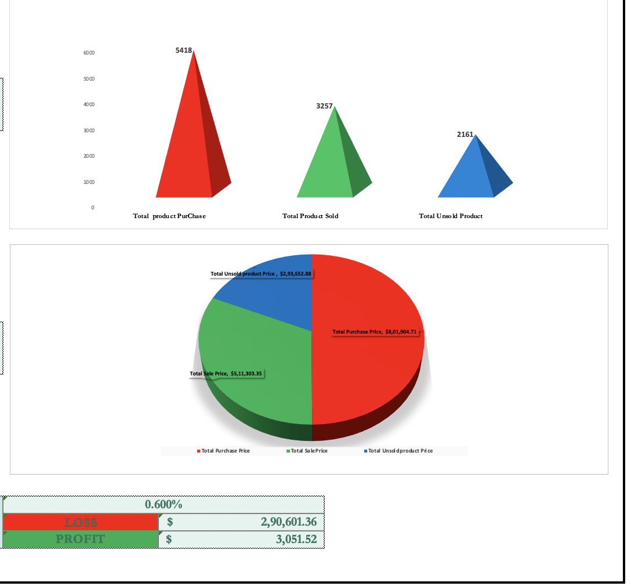
Dashboard and Report Generation
The dashboard provides graphical insights into:
Total purchases, sales, and unsold products.
Profit margins with and without unsold stock.
Visual representation of financial performance.
The report sheet generates shipment reports, summarizing sold and unsold items and their prices.

Slide 7
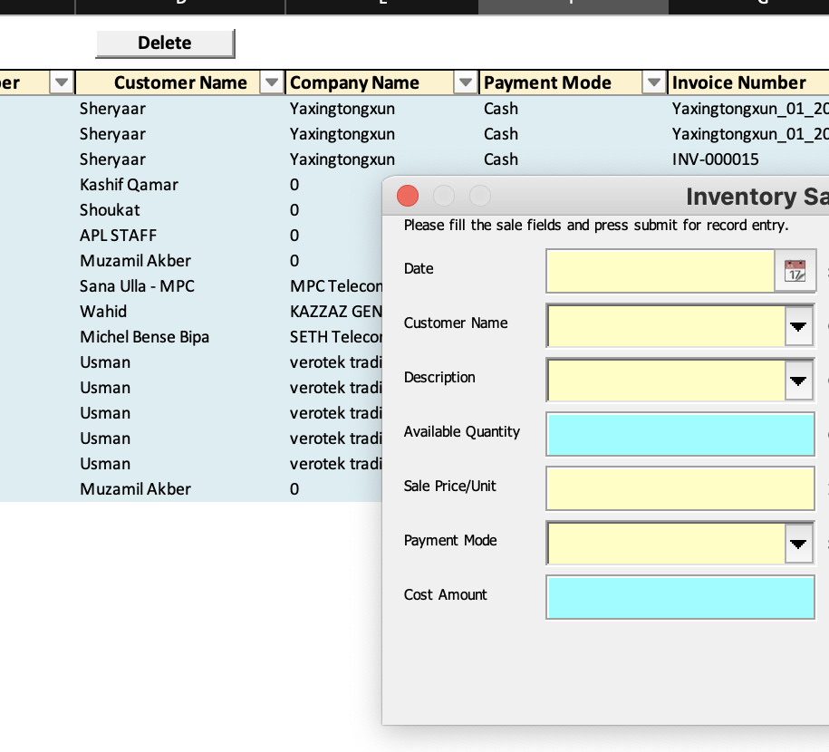
Automation via VBA
Key automation features powered by VBA:
Automatic table generation in the debit/credit sheet.
User forms for data entry, editing, and deletion.
Automatic calculation of financial figures and report generation.
Sheet protection and password management for admin access.

Slide 8
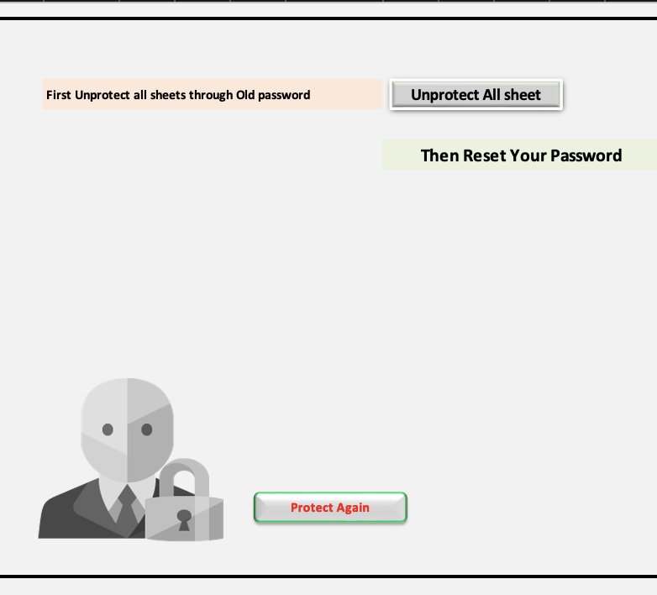
Security and Protection
The EcoLedger System ensures data security by:
Password-protected sheets for purchases and sales.
Admin sheet functionality to reset passwords and manage access.
Role-based access to safeguard sensitive information

Slide 9
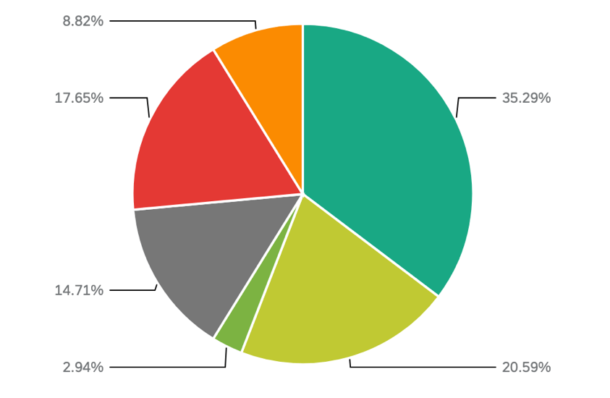
Results and Benefits
The EcoLedger System provides:
Increased accuracy in financial reporting.
Real-time insights for decision-making.
Secure access controls to protect company data.
Automation that saves time and reduces manual errors.

Slide 10

Conclusion
The EcoLedger System is a comprehensive solution for GreenLine Industries, integrating financial management, inventory tracking, and security in a single platform. By automating critical processes, the system enhances efficiency and provides accurate, real-time data to support business decisions.

Slide 11

Questions & Answers
Thank you! Any questions?

Slide 12


